Slide 1
Who Am I Building This for?
How Will They Use It?

Slide 2
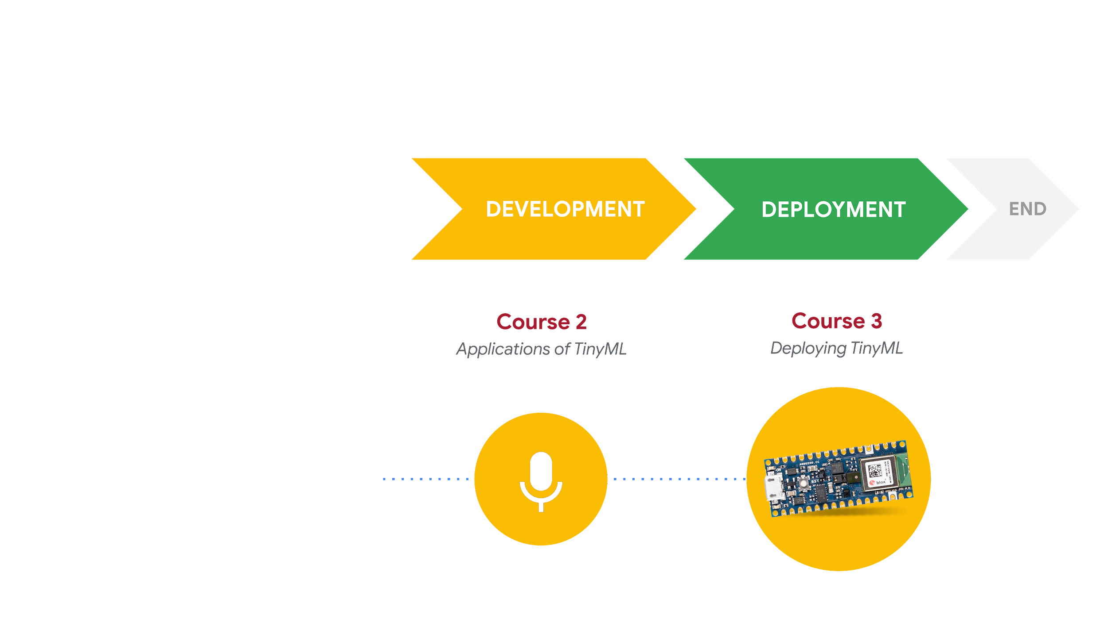
Responsible AI: Human-Centered Design
DESIGN
START
Course 1
Fundamentals of TinyML
What am I building?
Who am I building this for?
What are the consequences for the user if it fails?

Slide 3

Who am I building this for?
Who are the stakeholders impacted by the proposed technology?
Direct
aka the “User(s)”
Notes:
A second key point concerns the term “stakeholders”. Stakeholders are the people who will be impacted by a proposed piece of technology. There are direct stakeholders, who are typically people who would use your technology and would be colloquially referred to as “users”. Additionally, your technology may have indirect stakeholders, i.e., people who are not “users”, but are nonetheless impacted by your technology. For example, the passenger of a self-driving car would be a direct stakeholder, while nearby pedestrians on the street would be indirect stakeholders (if the car were to malfunction, they could be impacted).
https://commons.wikimedia.org/wiki/File:Emoji_u1f471_1f3fe_200d_2640.svg

Slide 4
Who am I building this for?
Who are the stakeholders impacted by the proposed technology?
Be specific!
Age
Gender
Physical abilities
Location
Direct
aka the “User(s)”
Notes:
http://citeseerx.ist.psu.edu/viewdoc/download?doi=10.1.1.106.5055&rep=rep1&type=pdf

Slide 5


Who am I building this for?
Who are the stakeholders impacted by the proposed technology?
Indirect
Notes:
A second key point concerns the term “stakeholders”. Stakeholders are the people who will be impacted by a proposed piece of technology. There are direct stakeholders, who are typically people who would use your technology and would be colloquially referred to as “users”. Additionally, your technology may have indirect stakeholders, i.e., people who are not “users”, but are nonetheless impacted by your technology. For example, the passenger of a self-driving car would be a direct stakeholder, while nearby pedestrians on the street would be indirect stakeholders (if the car were to malfunction, they could be impacted).
https://commons.wikimedia.org/wiki/File:Emoji_u1f64b_1f3fb_200d_2642.svg (LEFT)
https://commons.wikimedia.org/wiki/File:Emoji_u1f64b_1f3ff.svg

Slide 6


What do the stakeholders value?
Direct (Doctor)
Accuracy
Training/skill set
Ease of use
Research advances
Indirect (Patient)
Personal care
Being informed / autonomy
Trust
Privacy
Notes:
https://vsd.ccs.neu.edu/introduction/three-investigations/
http://www.envisioningcards.com/envision_pdfs/EC_Sample_Cards_Set.pdf
Doc: https://commons.wikimedia.org/wiki/File:Emoji_u1f469_1f3fe_200d_2695.svg
https://commons.wikimedia.org/wiki/File:Emoji_u1f471_1f3fd.svg

Slide 7
Do value tensions arise?
Direct (Doctor)
Accuracy
Training/skill set
Ease of use
Research advances
Indirect (Patient)
Personal care
Being informed / autonomy
Trust
Privacy

Slide 8
Do value tensions arise?
Direct (Doctor)
Accuracy
Training/skill set
Ease of use
Research advances
Indirect (Patient)
Personal care
Being informed / autonomy
Trust
Privacy
Notes:
Within a single individual (e.g. privacy and security)
Between an individual and a group
Across different groups

Slide 9
How can we resolve value tensions?
1
2
3
Is one of the conflicting values considered a right?
Do the stakeholders prioritize certain values?
Does the value have a threshold for sufficiency?

Slide 10
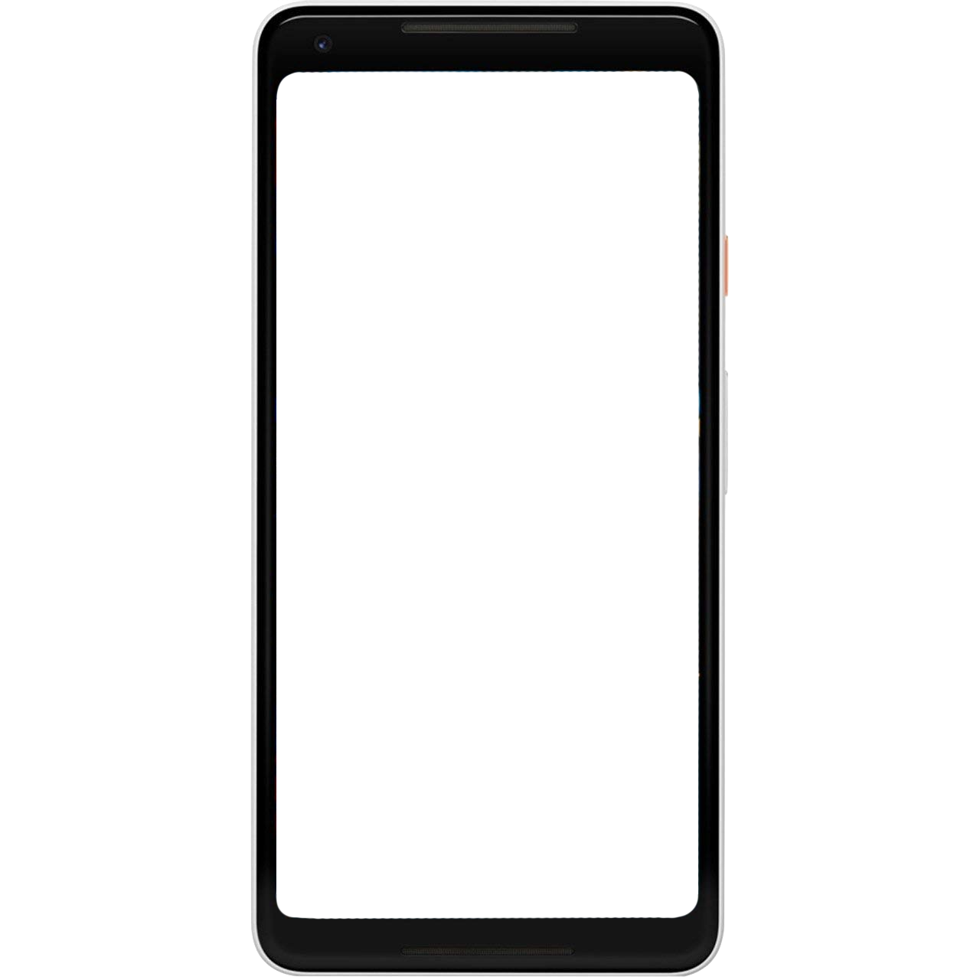
Consider diverse perspectives
How does this technology look when analyzed from diverse perspectives, particularly those that are historically marginalized or under-represented?

Slide 11
Consider diverse perspectives
How does this technology look when analyzed from diverse perspectives, particularly those that are historically marginalized or under-represented?
Example: How would the choice of command phrases look to...
People who are non-native English speakers?
People who speak African American Vernacular English?
People with speech impairments?

Slide 12
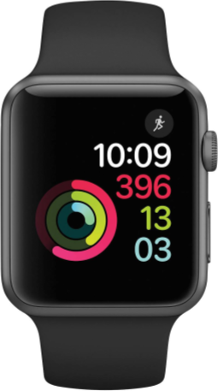
Consider social context
What is the social context in which the technology will be used? What features of this context are likely to impact access, adoption and use?

Slide 13
Consider social context
What is the social context in which the technology will be used? What features of this context are likely to impact access, adoption and use?
Example: If our intended users span different countries...
Will there be a digital divide?
Do the countries have different rules and regulations for data protection?
Do customs impact how users prioritize values?

Slide 14
We identified who we are building for…
But how are they going to use it?

Slide 15
How are they going to use it?
Multistability
Even if we design technology for a specific purpose, it may be compatible with immoral, malicious or simply unintended purposes
Notes:
https://ai.google/principles/
Google’s Responsible AI
Many technologies have multiple uses. We will work to limit potentially harmful or abusive applications. As we develop and deploy AI technologies, we will evaluate likely uses in light of the following factors:
Primary purpose and use: the primary purpose and likely use of a technology and application, including how closely the solution is related to or adaptable to a harmful use

Slide 16
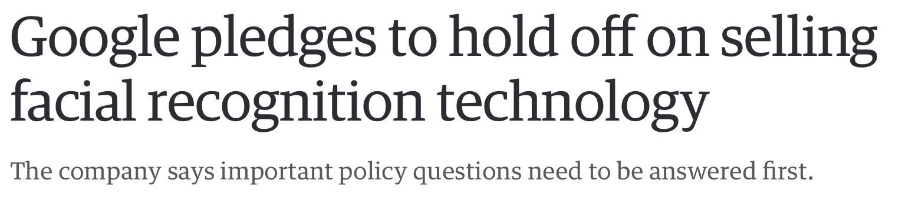
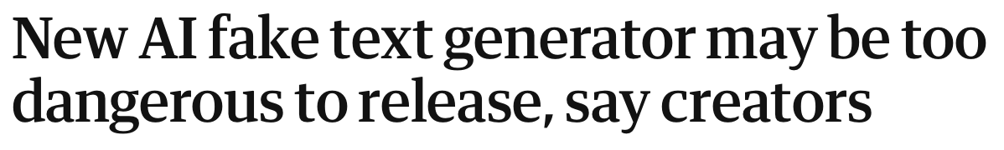
Notes:
https://www.theguardian.com/technology/2019/feb/14/elon-musk-backed-ai-writes-convincing-news-fiction
https://www.engadget.com/2018-12-13-google-hold-off-selling-facial-recognition-technology.html?guccounter=1&guce_referrer=aHR0cHM6Ly93d3cuZ29vZ2xlLmNvbS8&guce_referrer_sig=AQAAAK_4ig5MeCowQ9k2qyVZ0LnlX45-K93c4zGvcI5NQLcHjjenksg5i_wW4aGX5SLBT5IzZFb0QvvrWFXgPhPY70ndaal1QBNYeGyzCkf9UDBL1ixqrLT5ZXK5c02vx-8hzvqSk_AFQ2Uua9I8s09LLV6UotNcB8oUiaeASEoI7DfD

Slide 17

STOP
Notes:
https://www.theguardian.com/technology/2019/feb/14/elon-musk-backed-ai-writes-convincing-news-fiction
https://www.engadget.com/2018-12-13-google-hold-off-selling-facial-recognition-technology.html?guccounter=1&guce_referrer=aHR0cHM6Ly93d3cuZ29vZ2xlLmNvbS8&guce_referrer_sig=AQAAAK_4ig5MeCowQ9k2qyVZ0LnlX45-K93c4zGvcI5NQLcHjjenksg5i_wW4aGX5SLBT5IzZFb0QvvrWFXgPhPY70ndaal1QBNYeGyzCkf9UDBL1ixqrLT5ZXK5c02vx-8hzvqSk_AFQ2Uua9I8s09LLV6UotNcB8oUiaeASEoI7DfD
https://thenounproject.com/search/?q=stop+sign&i=651816

Slide 18


Non-Intended Use—What should we do?
STOP
Stop developing the technology altogether
CHANGE
Implement design choices to prevent or mitigate non-intended use
REPURPOSE
Embrace non-intended use and redesign for new purpose
Notes:
Stop: https://thenounproject.com/search/?q=stop+sign&i=651816
Pencil: https://thenounproject.com/search/?q=design&i=2472937
Return: https://thenounproject.com/search/?q=circle+arrows&i=1166995

